Slide 1
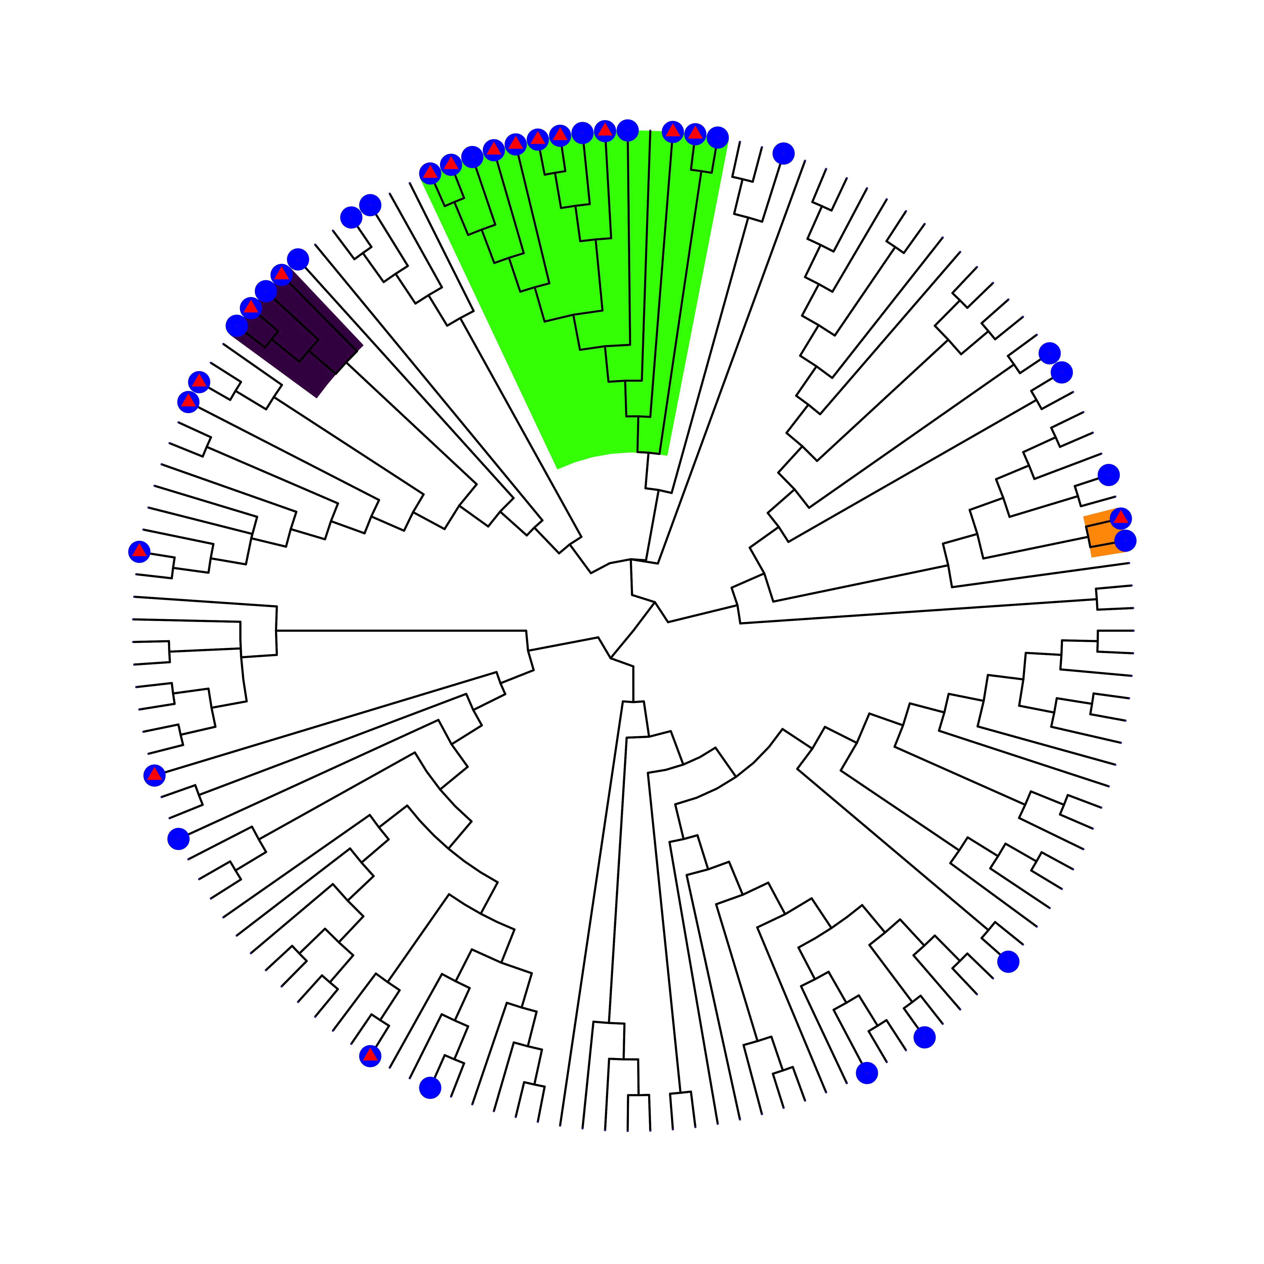
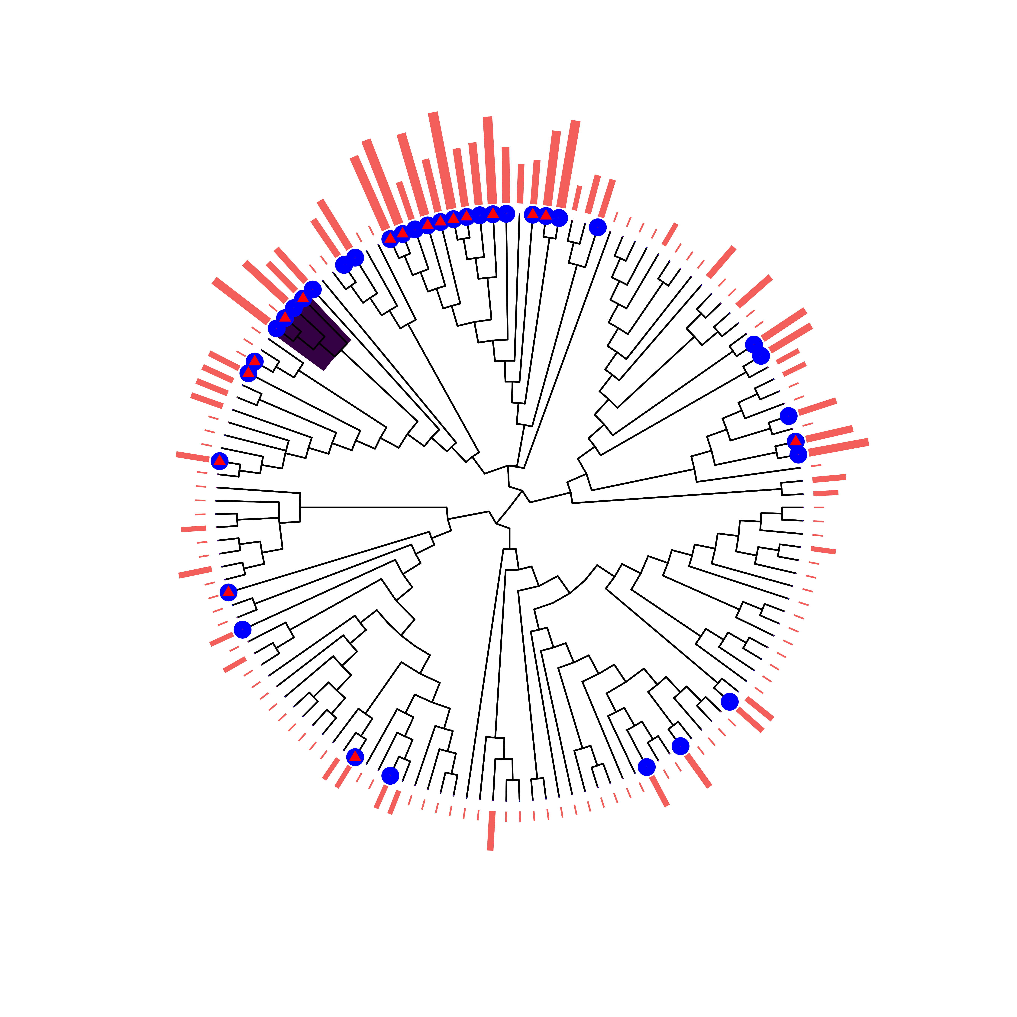
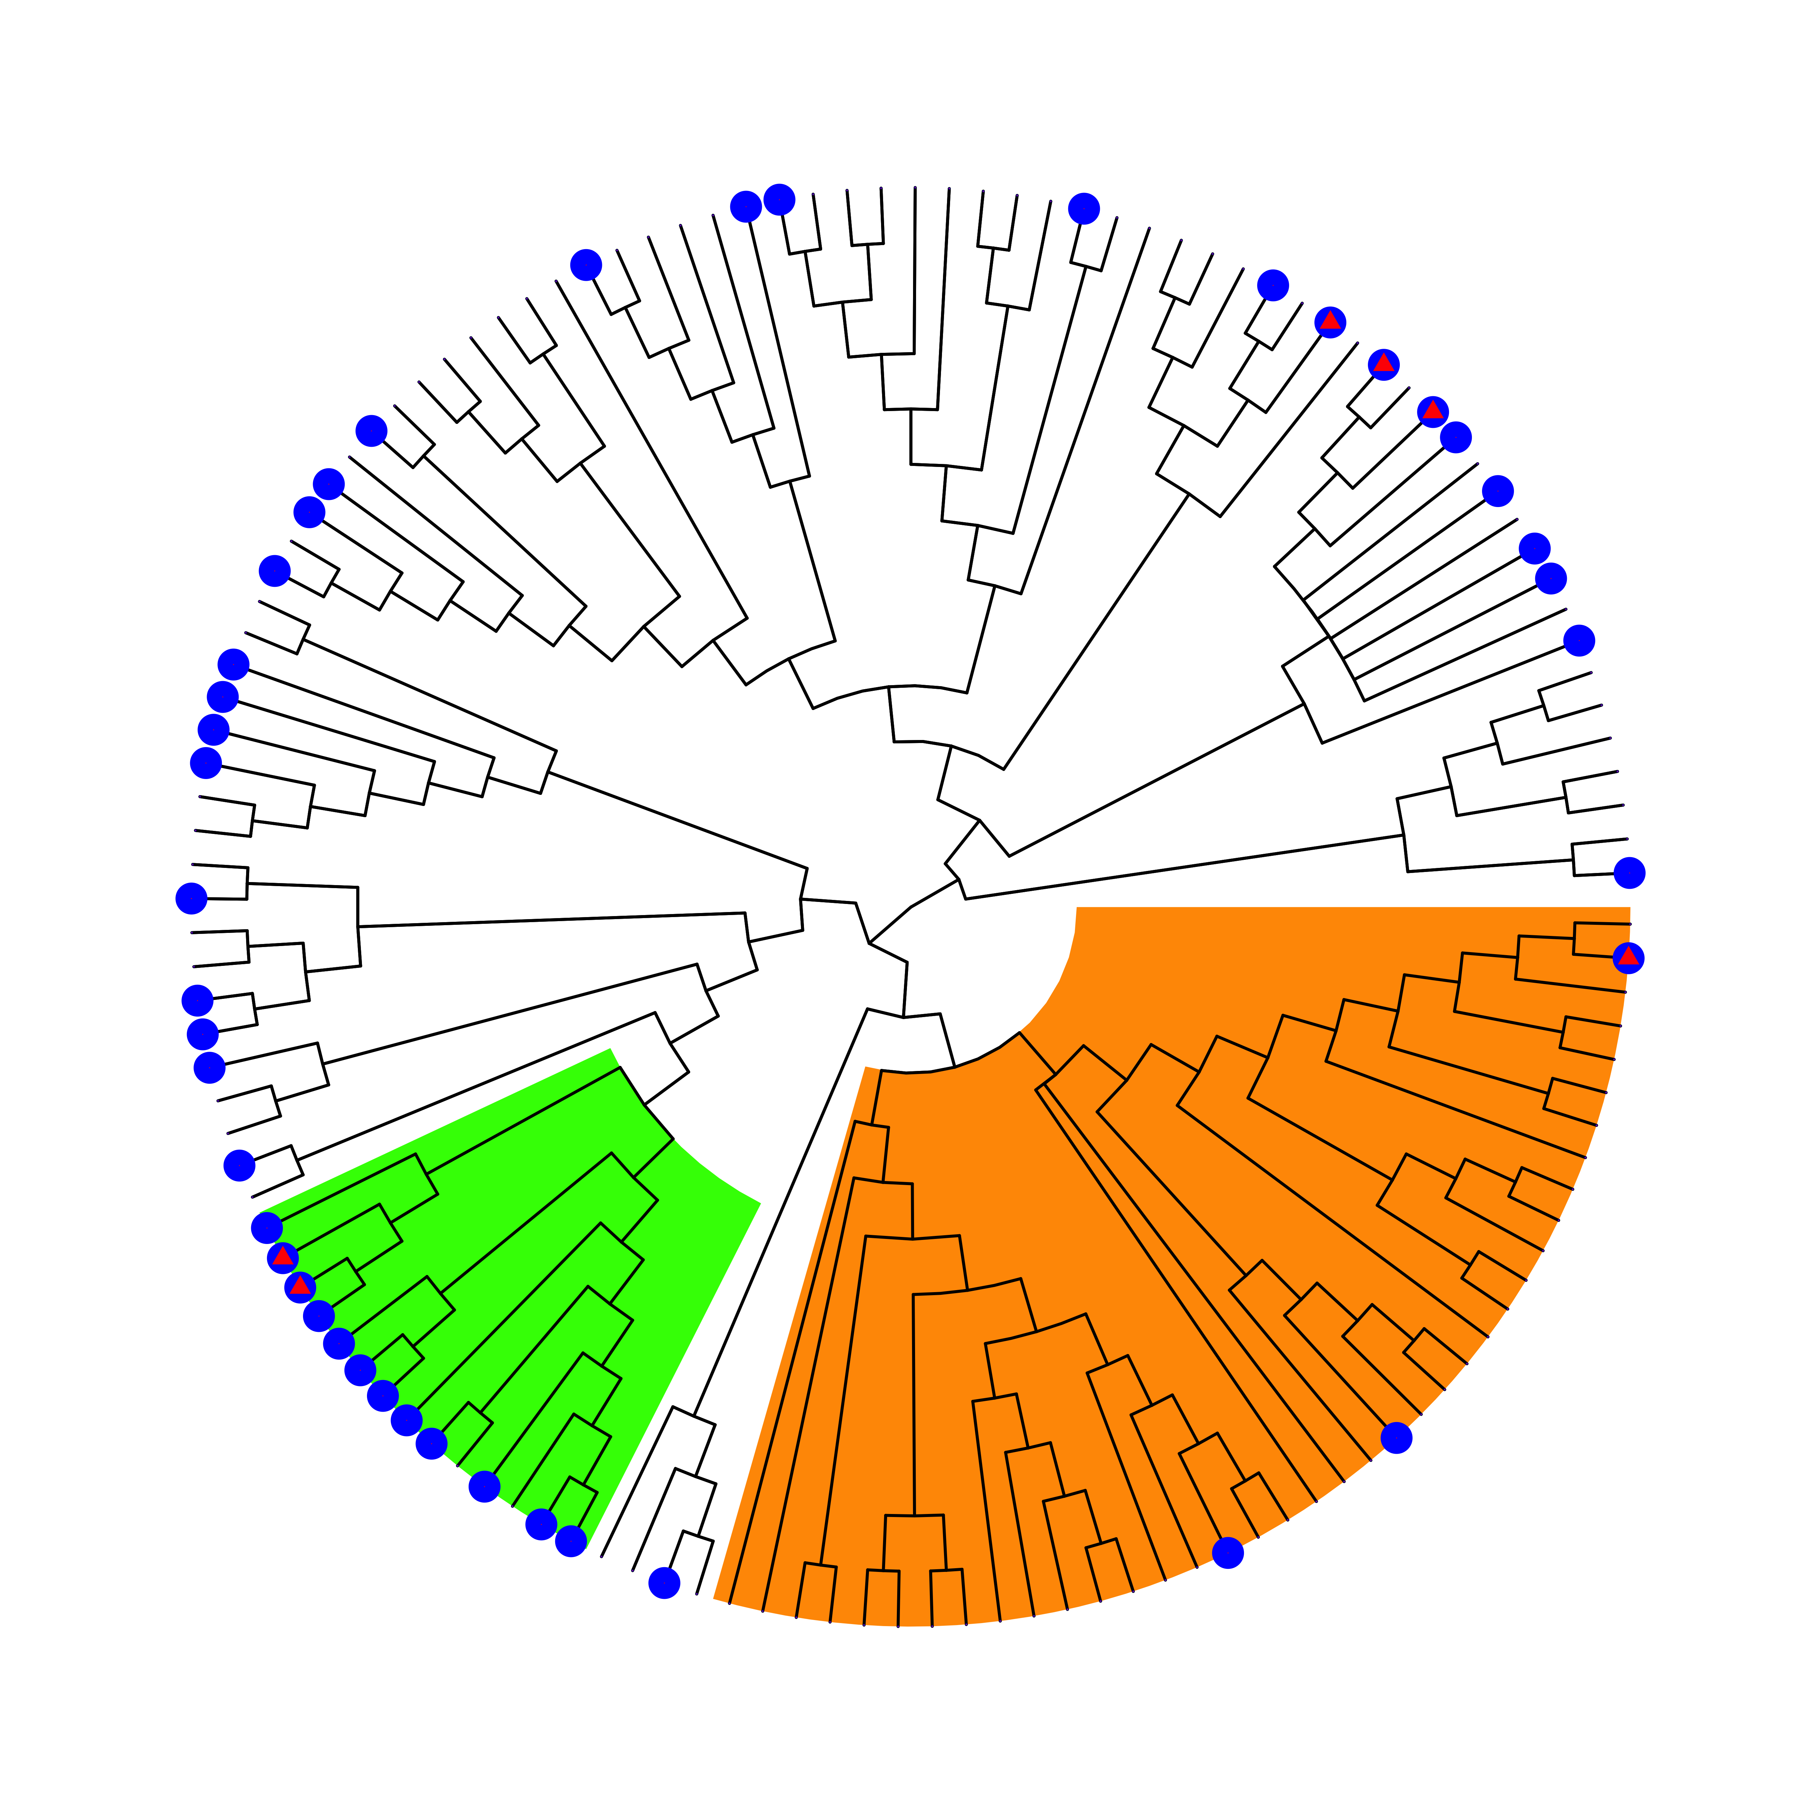
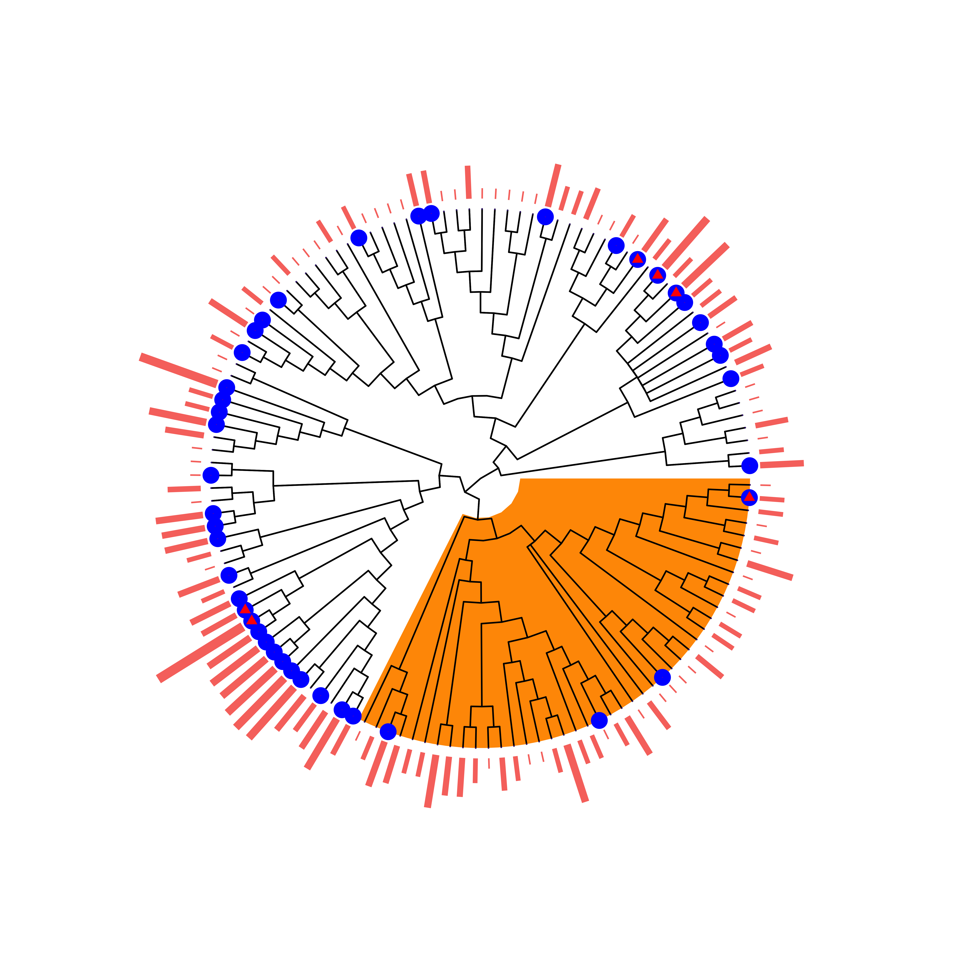

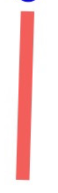
Ignoring Sampling Effort
Controlling for Sampling Effort
A
B
Henipavirus
Factor # | Name | Tax. Level | Species | % Species Positive | LOS
1 | Pteropodinae | Subfamily | 14 | 93 | < 0.01
2 | Rousettus | Genus | 4 | 100 | < 0.01
3 | Hipposideros | Genus | 2 | 100 | 0.058
- | Paraphyletic Remainder | - | 119 | 14 | -
Factor # | Name | Tax. Level | Species | % Species Positive | LOS
1 | Rousettus | Genus | 4 | 1 | .23
 | Paraphyletic Remainder |  | 135 | 0.237 | -
C
D
Filovirus
Key
Factor # | Name | Tax. Level | Species | % Species Positive | LOS
1 | Pteropodidae | Family | 14 | 86 | < 0.01
2 | Rhinolophoidea | Superfamily | 39 | 8 | < 0.01
- | Paraphyletic Remainder | - | 79 | 35 | -
Factor # | Name | Tax. Level | Species | % Species Positive | LOS
1 | Rhinolophoidea | Superfamily | 43 | 9.3 | 0.004
- | Paraphyletic Remainder | - | 89 | 43.8 | -
AB +
PCR +
1+ ln(Sampling Effort)

Slide 2
Motivation Problem:
Orange group was identified by phylofactor
The group only has 2 tips here, but actually the clade is much larger
The missing data is not seen by the algorithm and it won’t work if it is there.
However, this clade actually contains 20+ species

Slide 3
How does the algorithm work?
Creates a basis vector (a split point in the tree)
Maximizes an objective function using this basis vector (possibly -SSE)
Continues to try all basis vectors
Returns basis vector with maximum objective function
Which split point (basis function) minimizes the SSE

Slide 4
Two issues
Number of clades to select
Dealing with missing data

Slide 5
Can penalized Least Squares help?
Could help in selecting number of clades
TBD
Could also help with missing data, penalizing selecting clades where majority of data is missing

Slide 6
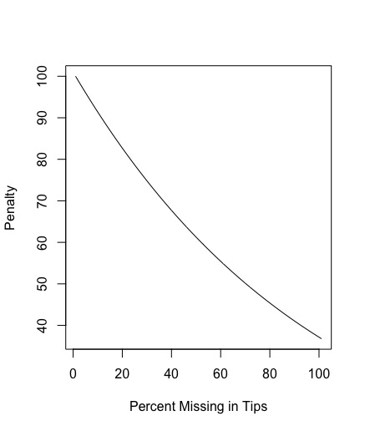
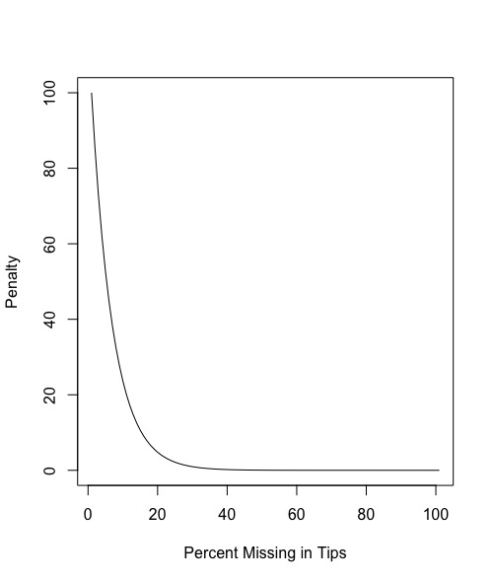
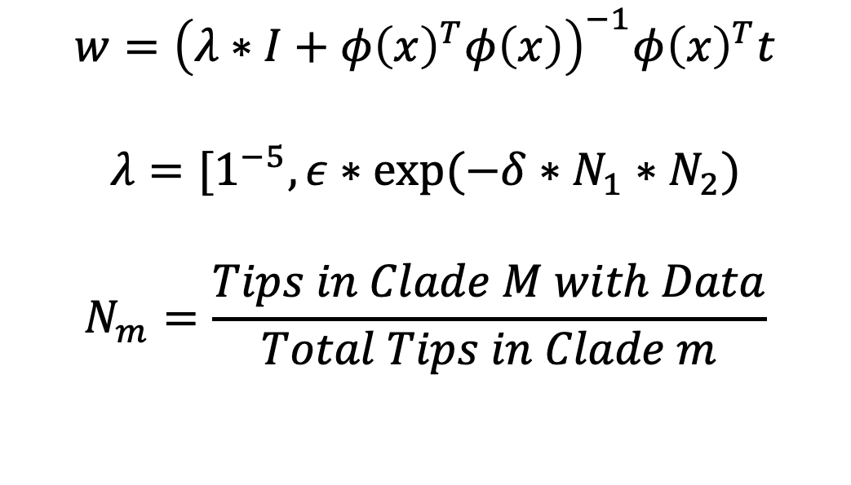
How should we penalize missing data?
$$w={\left(λ∗I+φ{\left(x\right)}^{T}φ\left(x\right)\right)}^{−1}φ{\left(x\right)}^{T}t$$
$$λ=[1^{−5}, ε∗exp⁡(−δ∗N_{1}∗N_{2})$$
$$N_{m}=\frac{Tips in Clade M with Data}{Total Tips in Clade m}$$
Our approach: ridge regression where lambda is a function of the amount of missing data
Delta = 1
Delta = 16

Slide 7
Process
Generate a tree with some data
Split the tree into training and testing
In the training set, remove some of the data simulating a situation in which we haven’t observed traits for some species
Find optimal penalty term using the testing data
Repeat the process for other split points

Slide 8
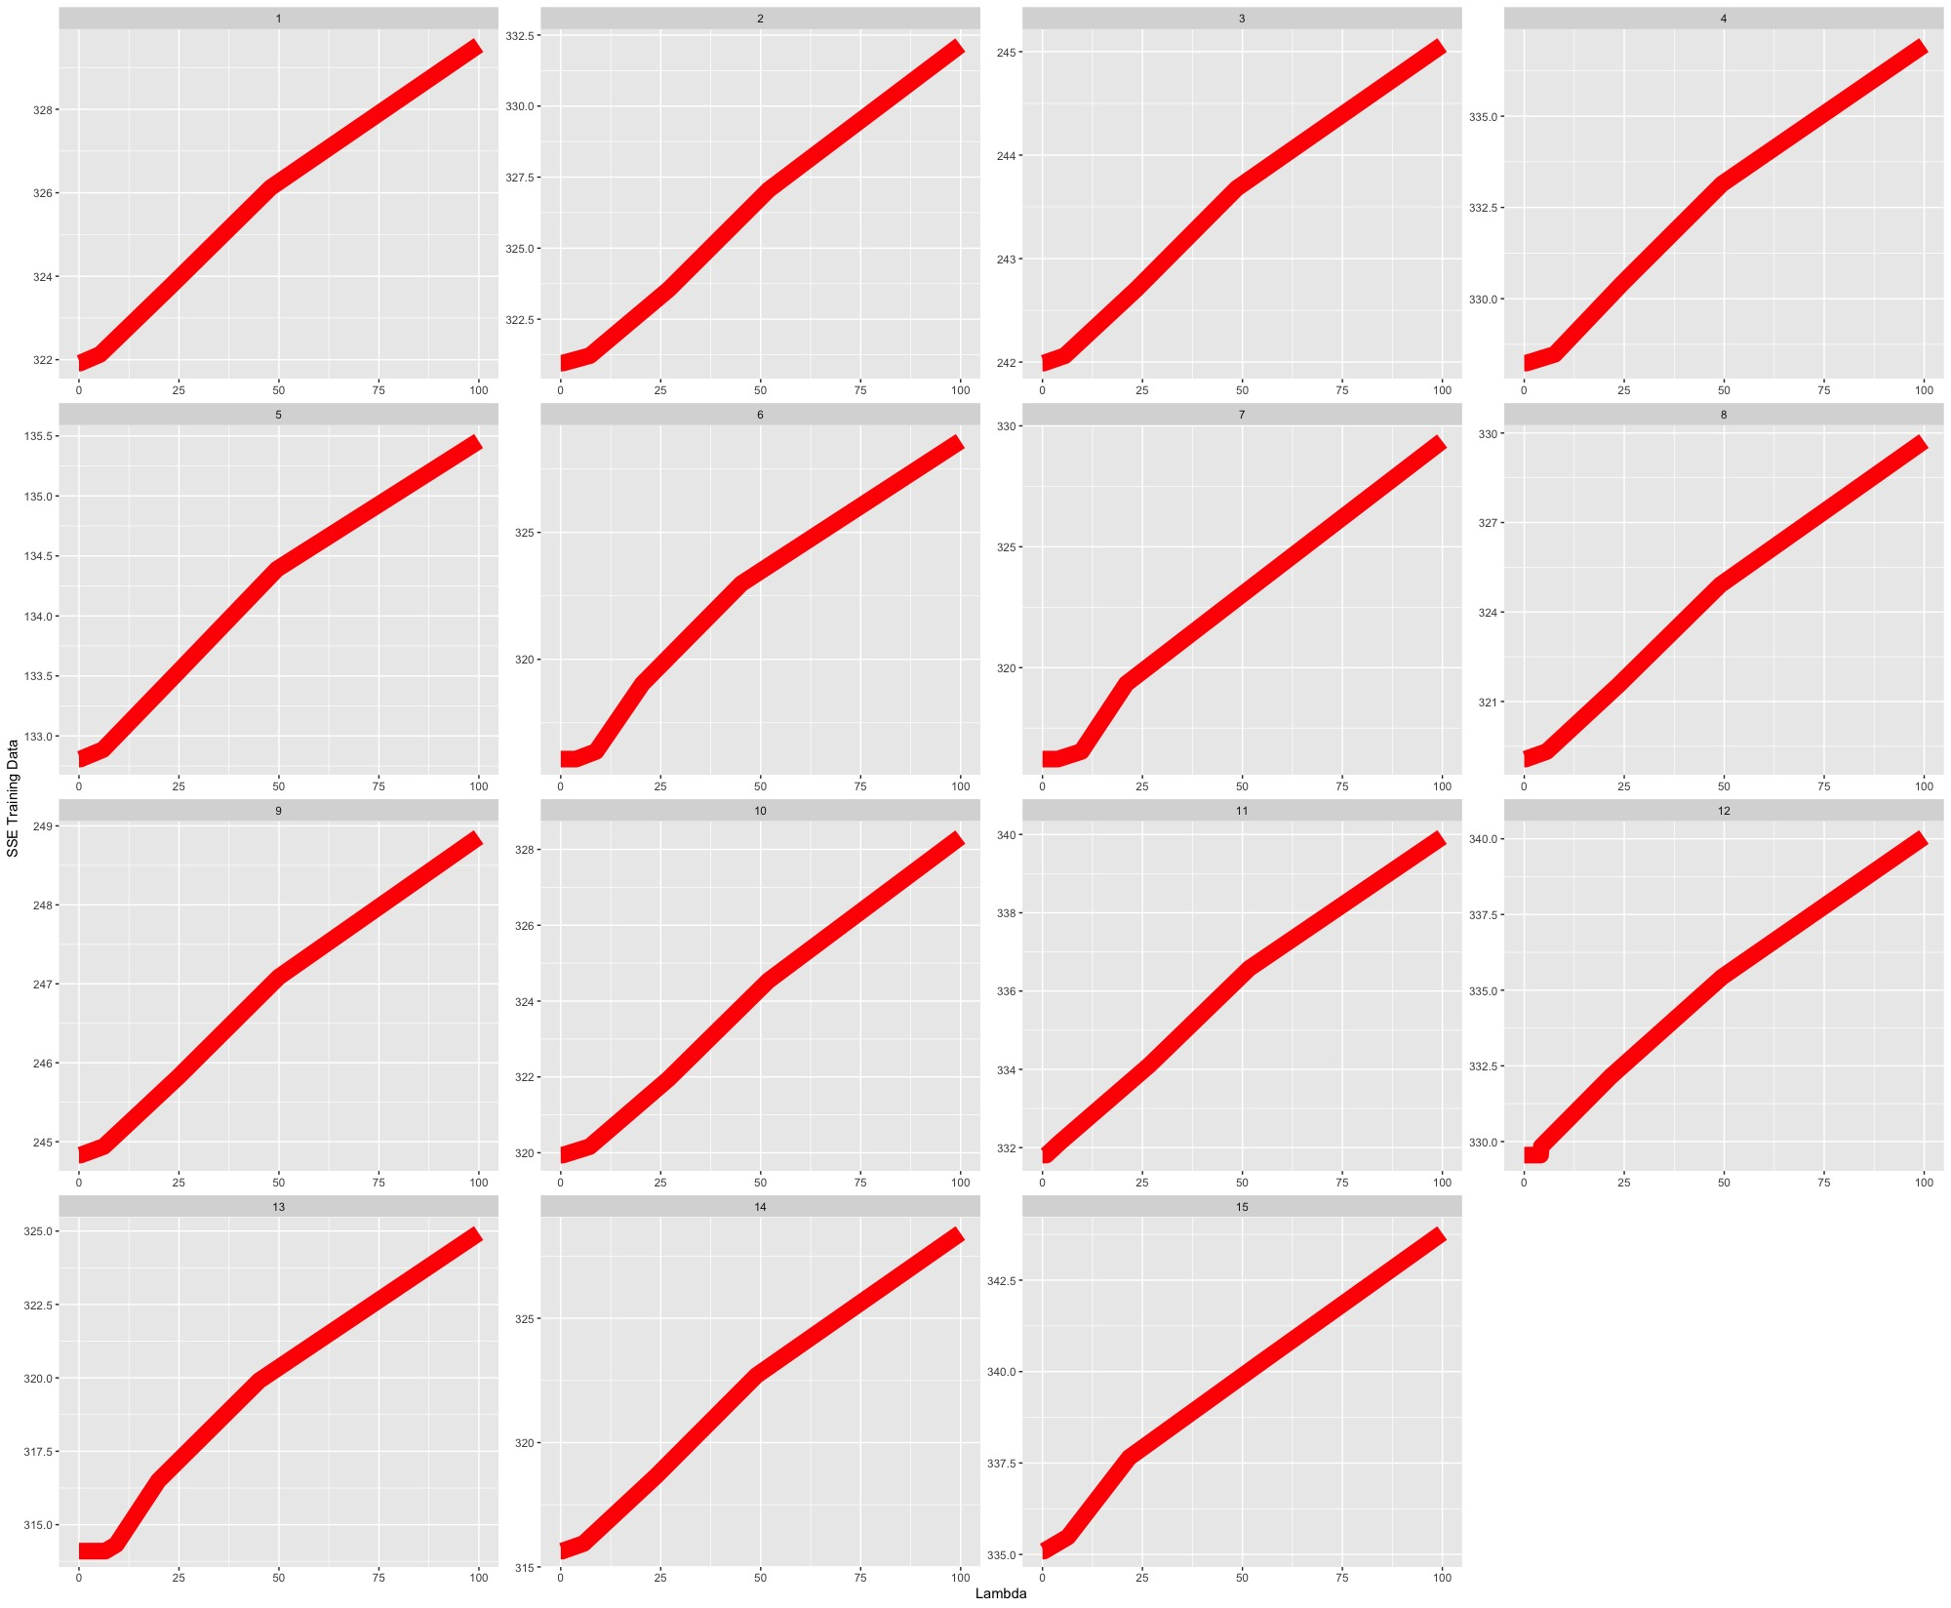
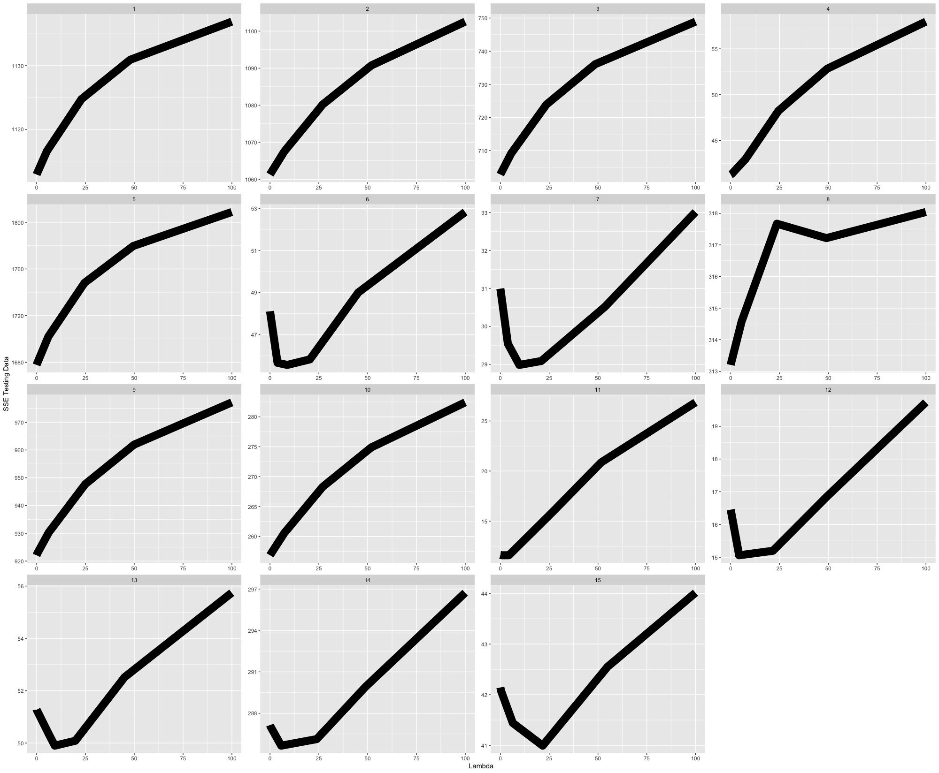
Results
What I was hoping to see with every simulation:

Slide 9
What we observed:
X axis: lambda
Y axis: SSE errors on the testing data
Each square is a testing and training split

Slide 10
As lambda gets larger, SSE of training data increases
X axis: lambda
Y axis: SSE errors on the training data
Each square is a different testing and training split

Slide 11
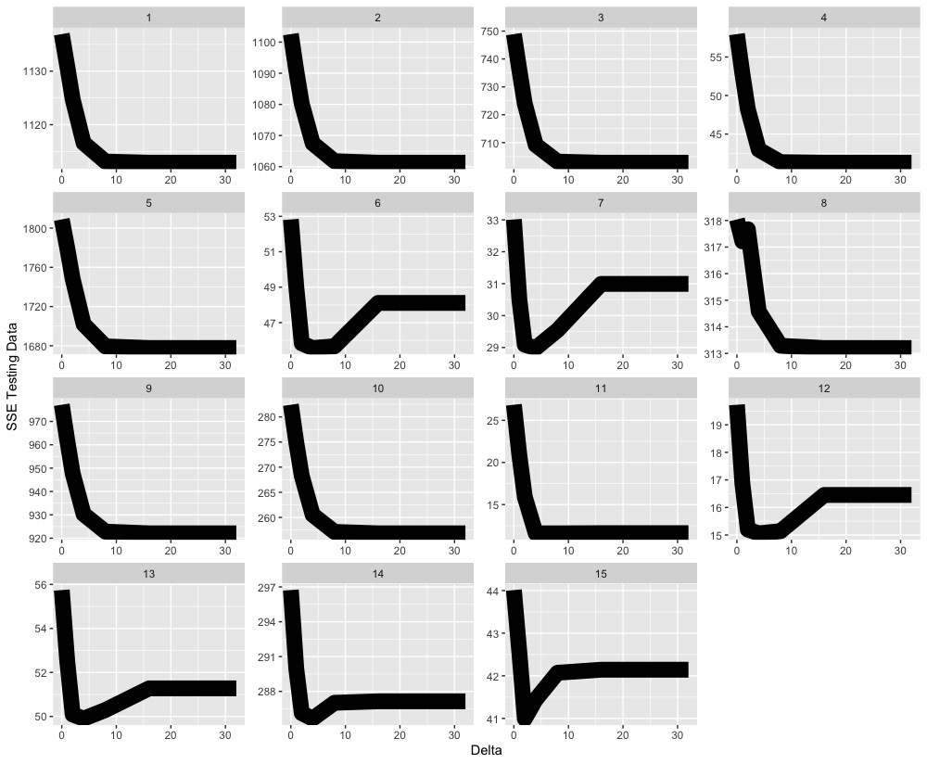
Comparing lambda and delta
X axis: lambda
Y axis: SSE errors on the testing data
Each square is a testing an training split
X axis: delta
Y axis: SSE errors on the testing data
Each square is a testing an training split
Notes:
Simulation 1:
Sometimes we are choosing the correct edge to split, and the penalty term is hurting us
Sometimes, we can improve our selection by imposing the penalty.
We are missing around 20% of our data here

Slide 12
Comparing lambda and delta
Ends up picking small clades with little missing data
X axis: lambda
Y axis: SSE errors on the testing data
Each square is a testing an training split
Notes:
Simulation 1:
Sometimes we are choosing the correct edge to split, and the penalty term is hurting us
Sometimes, we can improve our selection by imposing the penalty.
We are missing around 20% of our data here

Slide 13
Conclusions
The testing error does seem be an improvement over previous methods, especially in cases with missing tip information
Better form for penalizing missing data?
The bigger improvements will come once we can choose more than one clade

